Slide 1

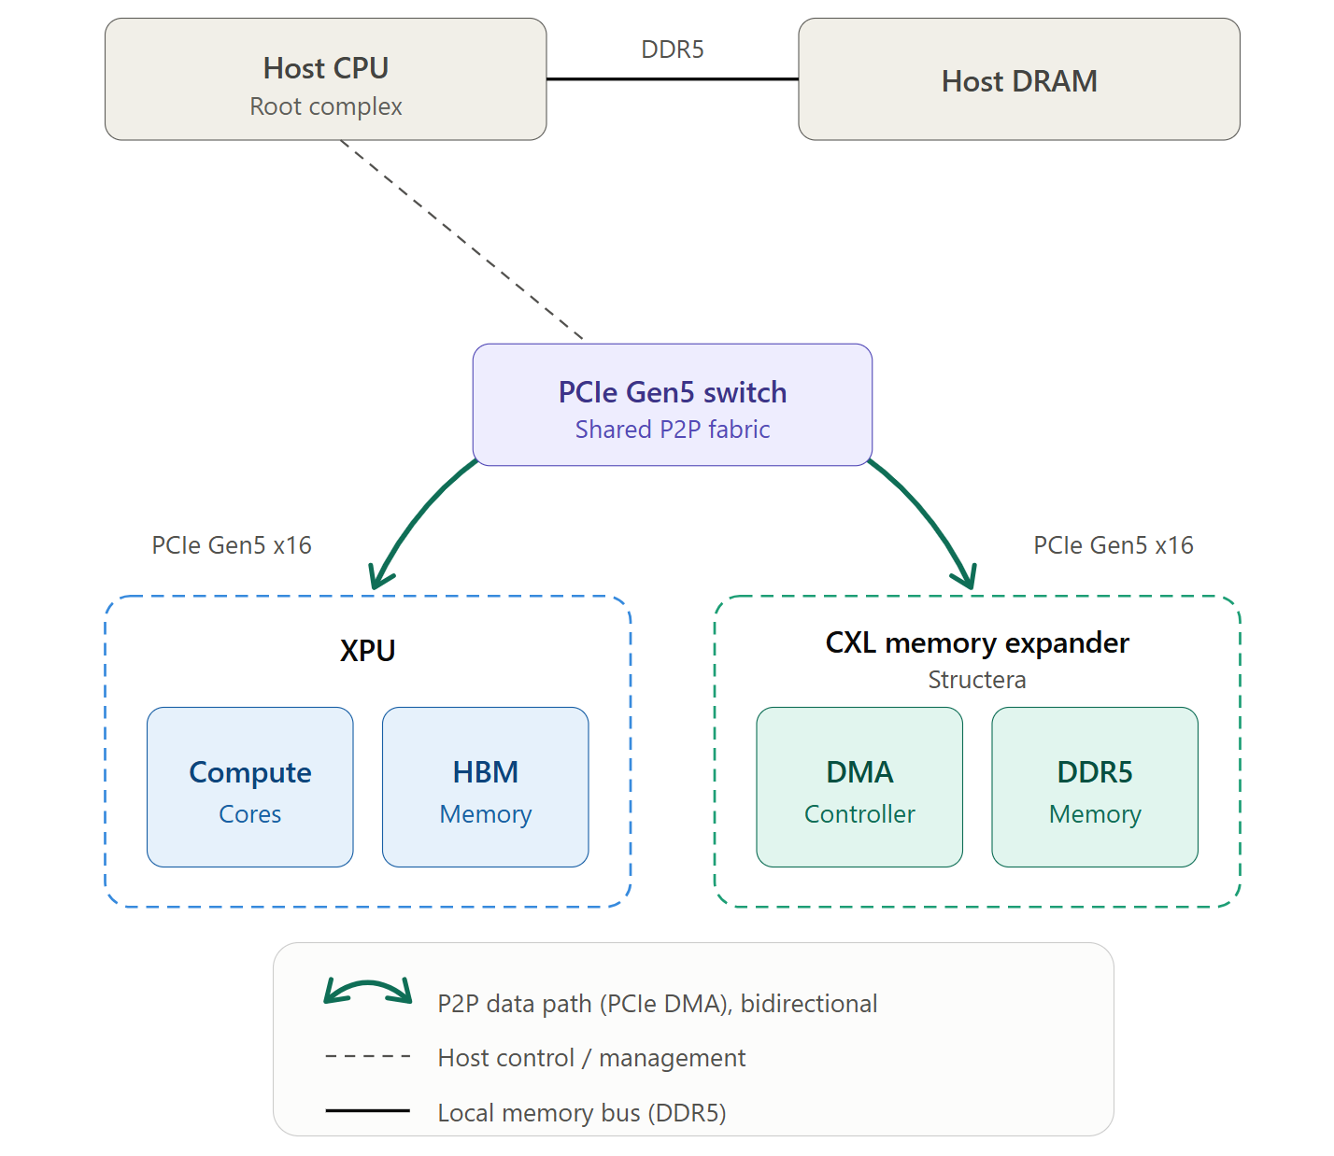
MARVELL
CXL Memory for LLM Inference Staging
via an On-Device DMA Controller
Veerasenareddy Burru · Pradeep Kumar Nalla · Alok Prasad · Satananda Burla
Marvell Technology · 18th ACM Workshop on Hot Topics in Storage & File Systems (HotStorage '26) · Prague · Sep 28–29, 2026
1 The Problem
2 Our Approach & Method
How an LLM serves a request
Direct GPU access to CXL memory
Prompt
Generate token
Append K,V
1
P2P DMA
user input
one model step
store in KV cache
The expander's DMA controller drives every transfer against GPU HBM; the GPU is passive.
repeat every token
2
Full host bypass
Each token reuses the cached keys & values of all earlier tokens — the KV cache.
The KV cache grows with output length and number of concurrent users.
No host DRAM, CPU, or IOMMU on the data path — a pure PCIe switch-domain transfer.
The KV cache fills GPU memory
3
Framework-compatible
HBM capacity
Appears as a GDS-style tier: no changes to vLLM, FlexGen, or NIXL.
KV cache
HBM holds fixed weights plus the growing KV cache.
Capacity — not compute — often caps how many requests you can serve.
When HBM fills, inference must shrink work, recompute, or spill off-GPU.
How it works: full host bypass
KV cache
GPU HBM
Shared PCIe switch
CXL expander (DMA)
Model
weights
Model
weights
Light load
Heavy load
The expander's DMA controller is the active party in every transfer.
GPU-facing traffic is plain PCIe P2P — CXL is used only host-side for capacity & management.
Shrink
Recompute
Spill off-GPU
cap batch / context
waste GPU cycles
if a tier is fast enough
Data Path
Structera A · Marvell CXL device
Why today's spill options fall short
NIXL ODM
plugin
descriptors
Marvell
kernel module
program ②
DMA
controller
CXL
memory
② PCIe P2P
GPU HBM
(VRAM)
Host DRAM
user space
kernel space
CPU + IOMMU overhead; a host-DRAM bounce; shares the bus with other traffic.
① Submission
② Execution
③ Completion
④ Pipelining
NVMe via GDS
post descriptors (io_uring), spray to 16 queues, ring doorbell
PCIe read/write direct to GPU HBM — no host DRAM / CPU / IOMMU
SQ↔CQ pairs; polled counter favors low latency
back-to-back; a core per queue keeps the link busy
Built for bulk block I/O — slow & high-latency on small, frequent transfers.
Experimental setup
RDMA
GPU
NVIDIA H200 NVL
Network-oriented and coarse-grained; throughput gated by network latency.
CXL expander
Marvell Structera A — on-device DMA controller
Expander memory
128 GB DDR5, 8 channels
What KV-cache staging needs
Interconnect
PCIe Gen5 ×16 · shared PCIe switch
Near-link bandwidth · low latency · host-bypass
Fine-grained 4 KB–128 KB access on a dedicated path
NVMe baseline
4× PCIe Gen5 ×4 SSDs (aggregate)
Host
AMD EPYC 9555 · 768 GB · Ubuntu 24.04 · CUDA 13.1
3 Results · CXL.DMA-P2P vs. NVMe-backed GDS
51 GB/s
29.7 GB/s
3–4 µs
> 10×
Peak read bandwidth
Peak write bandwidth
Read/write latency in KV range
Lower latency than NVMe/GDS
Read bandwidth vs. block size
Write bandwidth vs. block size
End-to-end latency vs. block size
PCIe Gen5 ×16 ≈ 64 GB/s
PCIe Gen5 ×16 ≈ 64 GB/s
KV cache range
KV cache range
KV cache range
NVMe baseline: 4× PCIe Gen5 ×4 SSDs (aggregate). Host DRAM measured on a shared PCIe bus with concurrent traffic. Dashed line = Gen5 ×16 link ceiling.
Key takeaways
Future work
Related work — where we fit
Reaches CXL memory over PCIe P2P DMA — no GPU changes.
High bandwidth, close to the Gen5 link on reads.
Order-of-magnitude lower latency than NVMe/GDS.
Biggest wins at KV-cache block sizes (4 KB–128 KB).
Write-path optimization: pipelining & write-combining.
Share one expander across GPUs / tenants.
On-expander KV compression; end-to-end in vLLM / TensorRT-LLM.
LLM memory mgmt (vLLM, FlexGen, Mooncake): we add a faster spill tier.
GPU storage offload (GDS, InstInfer): same host-bypass, faster medium.
CXL + GPU (Pond, CXL-GPU, LMB): no GPU changes — pure PCIe P2P.
Paper: https://doi.org/10.1145/3837053.3837356
{vburru, pnalla, palok, sburla}@marvell.com
Essential technology, done right™

